Slide 1
DMA: Direct Memory access
a crucial resource in embedded and general purpose o.s. design
CIS-657 Principles of Operating Systems
Taught By Dr. Mohammed Abdallah
Anthony Redamonti

Slide 2
Background
Many computing applications require data transfer between peripheral devices and memory.
Common Peripheral Devices:
External Hard Drive
Disk
Microphone
Video Camera
TV Screen
Projector

Slide 3
Problem statement
There are two methods of data transfer:
CPU watches status bits and feeds data into a control register one byte at a time.
Not a good idea!!!
Side effects: Delays in all applications, data transfer latency, power consumption.
Think “big brain, big task”.
Direct Memory Management (DMA)

Slide 4
What is DMA?
DMA is a feature of computer systems that relieves the CPU from performing data transfer.
Major Components: DMAC (DMA Controller), DMA Channels
DMAC increments memory pointers and is programmed by the CPU before initializing the transfer.
There are multiple DMA channels, each capable of performing an independent transfer.

Slide 5
Example: Transfer 10 bytes from flash to SRAM
CPU must perform the following loop 10 times:
Copy the value in Flash and store it in a general-purpose register.
Copy the value in the general-purpose register to the Accumulator register.
Copy the Accumulator value to the desired destination memory location in SRAM.
If all data has been transferred, end. If not, increment the Flash pointer.
Increment SRAM pointer.
Jump to step 1.

Slide 6
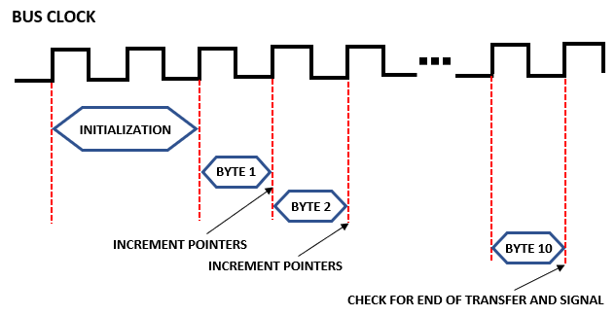
Example: transfer 10 bytes from flash to sram

Slide 7
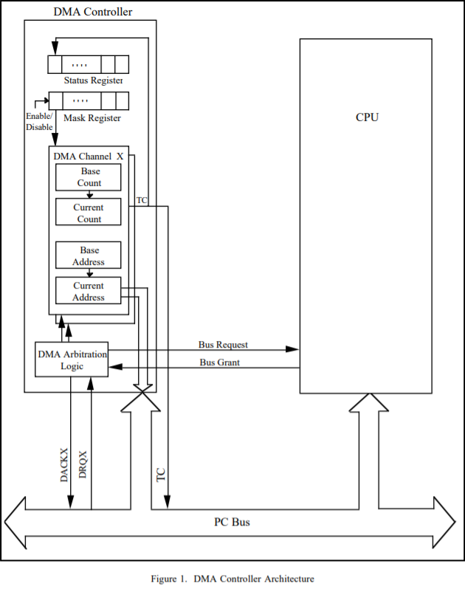
DMA Transfer From Peripheral to Memory
The device requesting DMA sends the Bus Request signal to the CPU.

Slide 8
DMA Transfer From Peripheral to Memory
The device requesting DMA sends the Bus Request signal to the CPU.
After completing the current bus cycle, CPU sends Bus Grant signal.

Slide 9
DMA Transfer From Peripheral to Memory
The device requesting DMA sends the Bus Request signal to the CPU.
After completing the current bus cycle, CPU sends Bus Grant signal.
DMAC loads Base Count and Base Address Registers, copies them to the Current Count and Current Address Registers.

Slide 10
DMA Transfer From Peripheral to Memory
The device requesting DMA sends the Bus Request signal to the CPU.
After completing the current bus cycle, CPU sends Bus Grant signal.
DMAC loads Base Count and Base Address Registers, copies them to the Current Count and Current Address Registers.
To initialize the transfer, the DMAC set the appropriate bit in the Mask Register to enable the appropriate channel.

Slide 11
DMA Transfer From Peripheral to Memory
The Current Address Register is incremented or decremented with each transfer.

Slide 12
DMA Transfer From Peripheral to Memory
The Current Address Register is incremented or decremented with each transfer.
The Current Count Register is decremented with each transfer, and when it transitions from 0 to -1, the terminal count (TC) signal is issued.

Slide 13
DMA Transfer From Peripheral to Memory
The Current Address Register is incremented or decremented with each transfer.
The Current Count Register is decremented with each transfer, and when it transitions from 0 to -1, the terminal count (TC) signal is issued.
The TC signal interrupts the CPU, signifying that the transfer has completed. The bus is returned to the CPU.

Slide 14
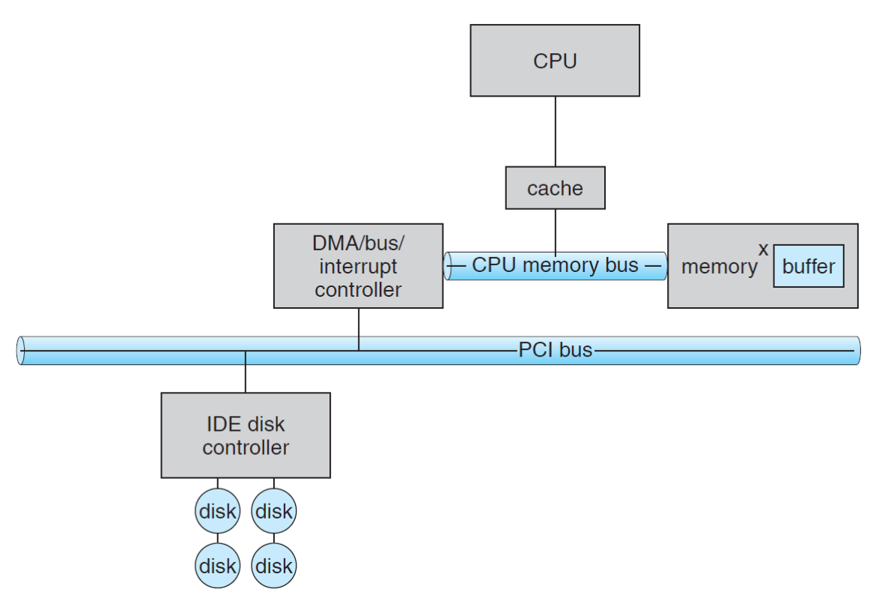
Example: Transfer From Disk to Memory
“Cycle Stealing” refers to the DMA sharing the system bus with the CPU.
It is not quite accurate as CPU can do some work in parallel using cache memory.
Therefore, the CPU must update any values in cache if they are changed (dirty) in memory by DMA.
Destination
Source
Silberschatz, Galvin and Gagne 2009

Slide 15
Test: CPU vs DMA
Use CPU to transfer 3200 bytes from memory to memory (no peripheral device).
LEDToggle(LEDB);
for (i = 0; i < ARRAYSIZE; i++)
{
destination[i] = source[i];
}
LEDToggle(LEDB);

Slide 16
Test: CPU vs DMA
Use DMA to transfer 3200 bytes from memory to memory (no peripheral device).
//LED on before the transfer
LEDToggle(LEDG);
//Enable DMA1 Channel transfer
DMA_Cmd(DMA1_Channel1, ENABLE);
while (status == 0) {};

Slide 17
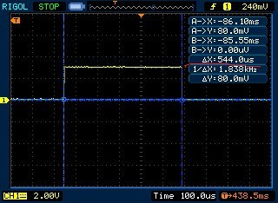
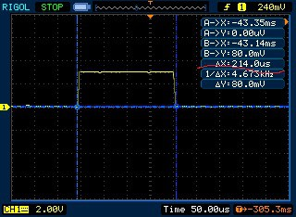
Results
CPU = 544 µsec
DMA = 214 µsec

Slide 18
3 types of dma
Block Mode – CPU is not allowed access to the memory bus until the transfer has completed.
Burst Mode – also known as cycle stealing mode, the DMA will request control periodically for a few cycles before releasing back to CPU. Process continues until the transfer is complete. Most popular type of DMA.
Transparent Mode – DMA only has control of the bus when the CPU is not using it.

Slide 19
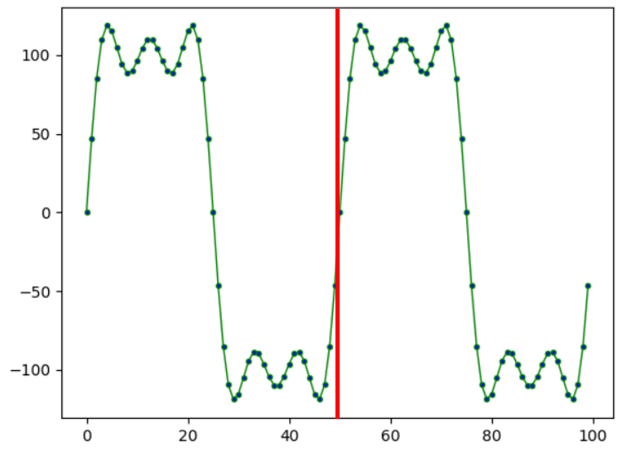
Real-time applications
Process data while receiving data in real time.
Need to increase transfer speed. Use a double buffer!

Slide 20
Double buffer
6 | 2 | 4 | 6 | 3 | 3 | 1 | 9 | 0 | 2 | 4 | 4 | 7 | 9
Back_End pointer
Front_End pointer
int Back_End[10]; // old data processed by CPU
int Front_End[10]; // DMA feeds new data here
Two arrays in memory (usually adjacent)

Slide 21
Double buffer
4
9
9
0
7
8
6
6
2
4
6
3
1
3
1
9
0
7
2
0
4
4
7
9
8
4
3
8
9
0
Back_End pointer
Front_End pointer
Front_End fills up and the pointers are switched.

Slide 22
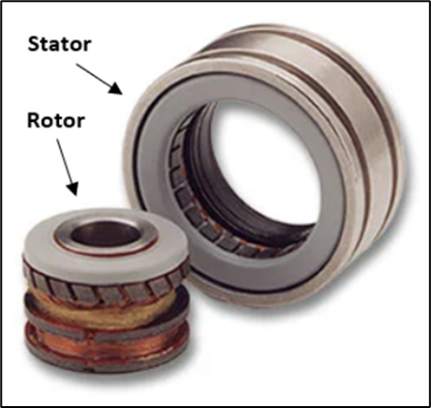
DMA Application: Servo drives
Resolver Feedback Type
Copley Serial Resolver Board

Slide 23
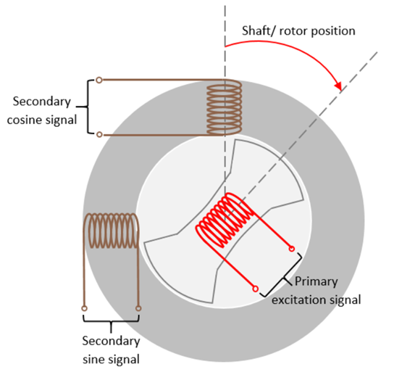
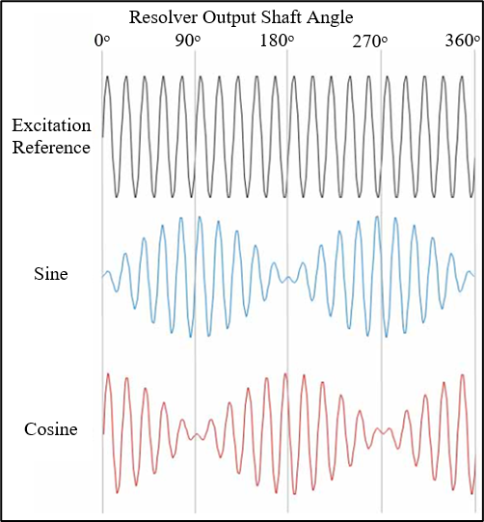

Slide 24
Dac: output waveform
Use Lookup table to generate sine wave
// DMA channel 1 is used to update the D/A value every time the timer updates.
dma->intClr = 0x000000FF;
dma->channel[0].config = 0x00000000;
dma->channel[0].count = TBL_LEN;
dma->channel[0].pAddr = (uint32_t)&dac->r12;
dma->channel[0].mAddr = (uint32_t)sineTbl; dma->channel[0].config = 0x000035B6;

Slide 25
ADC: read input waveforms
DMA channel 3 to read the ADC data
dma->intClr = 0x000000FF; // only using two DMA channels so FF is used
dma->channel[3].config = 0x00000000;
dma->channel[3].count = 2; // 2 ADC channels
dma->channel[3].pAddr = (uint32_t)&adc->data; // reading from this register in the A/D converter
dma->channel[3].mAddr = (uint32_t)adcData; // destination buffer
dma->channel[3].config = 0x00000583;

Slide 26
